Slide 1
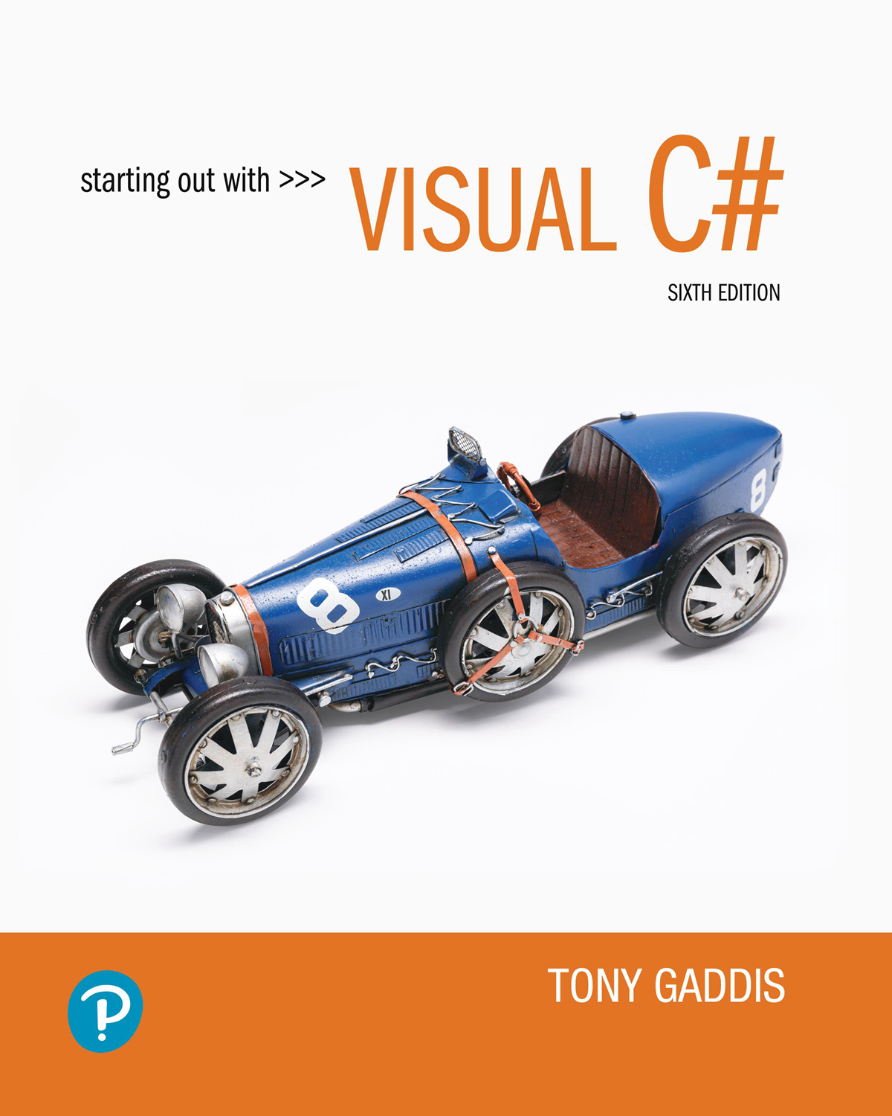

Starting Out with Visual c sharp
Sixth Edition
Chapter 3
Making Decisions
Copyright © 2023, 2017, 2014 Pearson Education, Inc. All Rights Reserved
Notes:
If this PowerPoint presentation contains mathematical equations, you may need to check that your computer has the following installed:
1) MathType Plugin
2) Math Player (free versions available)
3) NVDA Reader (free versions available)

Slide 2
Topics
4.1 Decision Structures and the if Statement
4.2 The if-else Statement
4.3 Nested Decision Structures
4.4 Logical Operators
4.5 bool Variables and Flags
4.6 Comparing Strings
4.7 Preventing Data Conversion Exceptions with the TryParse Method
4.8 Input Validation
4.9 Radio Buttons and Check Boxes
4.10 The switch Statement
4.11 Introduction to List Boxes

Slide 3
4.1 Decision Structures & the if Statement
A control structure is a logical design that controls the order in which statements execute
A sequence structure is a set of statements that execute in the order that they appear
A decision structure execute statements only under certain circumstances
  A specific action is performed only if a certain condition exists
  Also known as a selection structure

Slide 4
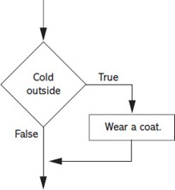
A Simple Decision Structure
The flowchart shown here is a single-alternative decision structure
It provides only one alternative path of execution
In
you can use the if statement to write such structures. A generic
format is:
if (expression)
{
statement
statement
etc.
}
The expression is a Boolean expression that can be evaluated as either true or false

Slide 5
Relational Operators
A relational operator determines whether a specific relationship exists between two values
Operator | Meaning | Expression | Meaning
> | Greater than | x > y | Is x greater than y?
< | Less than | x < y | Is x less than y?
>= | Greater than or equal to | x >= y | Is x greater than or equal to y?
<= | Less than or equal to | x <= y | Is x less than or equal to you?
== | Equal to | x == y | Is x equal to y?
!= | Not equal to | x != y | Is x not equal to you?

Slide 6
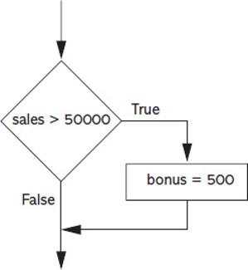
An if Statement with a Boolean Expression
if (sales > 50000)
{
bonus = 500;
}

Slide 7
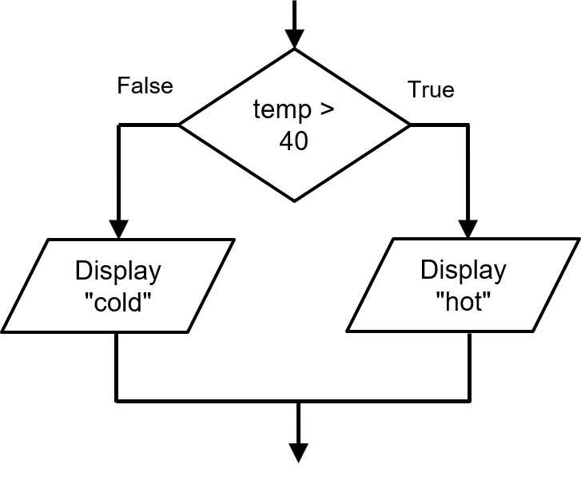
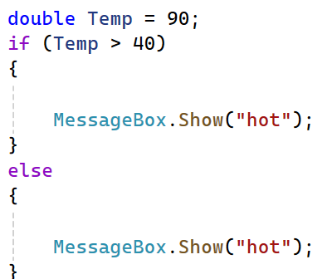
4.2 The if-else Statement
An if-else statement will execute one block of statement if its Boolean expression is true or another block if its Boolean expression is false
It has two parts: an if clause and an else clause
In
a generic format looks like this:
if (expression)
{
statements
}
else
{
statements
}

Slide 8
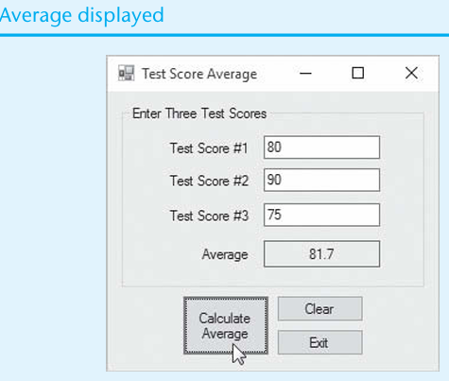
Practice for lap

Slide 9
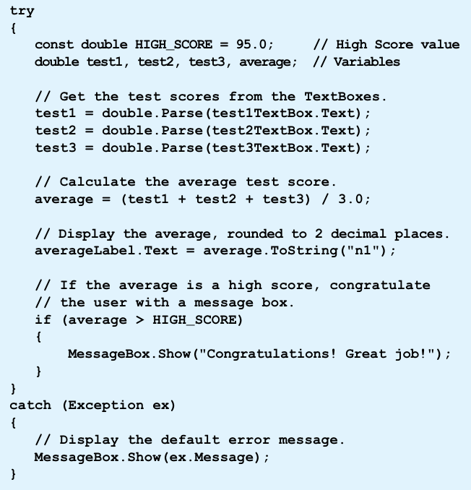
Code

Slide 10
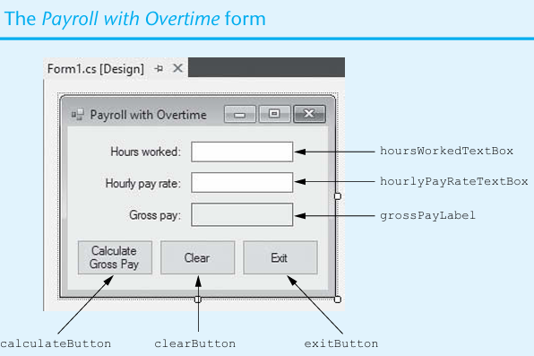
Home Assignment

Slide 11
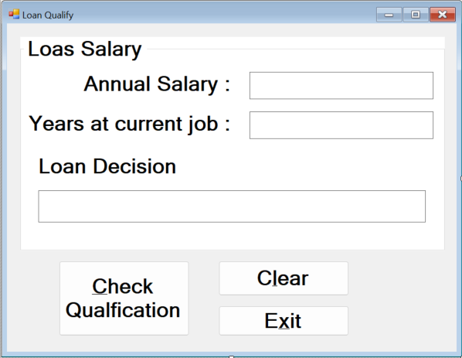
4.3 Nested Decision Structures
You can create nested decision structures to test more than one condition.
Nested means “one inside another"
if (expression)
{
if (expression)
{
statements
}
else
{
statements
}
}
else
{
statements
}
Practice Lap

Slide 12
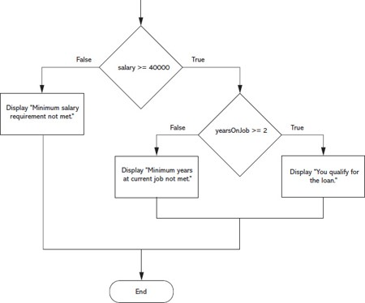
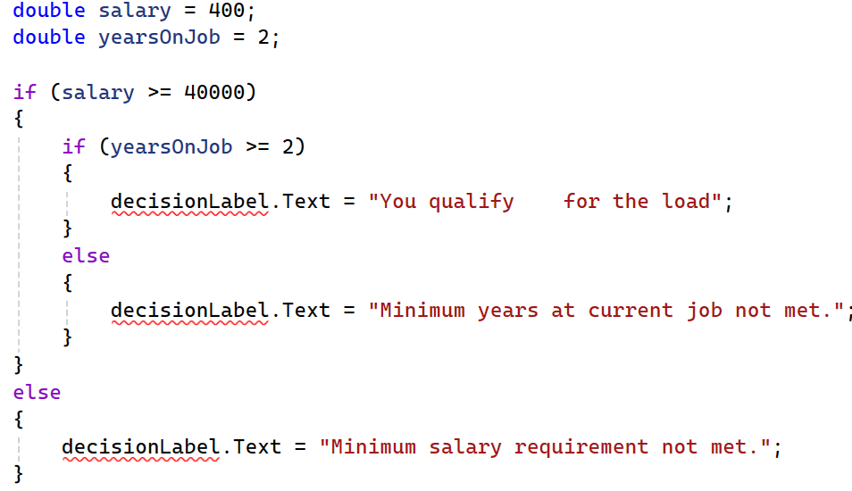
A Example Nested Decision Structure
Notes:
If false, a path proceeds to the statement, display double quote minimum salary requirement not met double quote. If true, a path proceeds to the statement, years on job greater than or equal to 2. If false, a path proceeds to the statement, display double quote minimum years at current job not met double quote. If true, a path proceeds to the statement, display double quote you qualify for the loan double quote. All paths proceed to the statement, end.

Slide 13
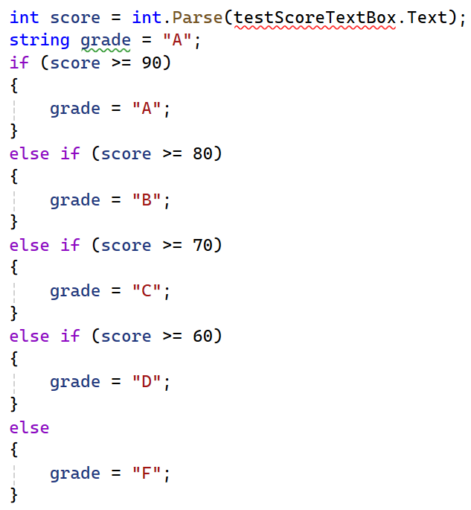
The if-else-if Statement
You can also create a decision structure that evaluates multiple conditions to make the final decision using the if-else-if statement
In
the generic format is:
if (expression)
{
statements
}
else if (expression)
{
statements
}
else if (expression)
{
statements
}
else
{
statements
}

Slide 14
4.4 Logical Operators
The logical AND operator (&&) and the logical OR operator (||) allow you to connect multiple Boolean expressions to create a compound expression
The logical NOT operator (!) reverses the truth of a Boolean expression
Operator | Meaning | Description
&& | AND | Both subexpression must be true for the compound expression to be true
|| | OR | One or both subexpression must be true for the compound expression to be true
! | NOT | It negates (reverses) the value to its opposite one.
Expression | Meaning
x >y && a < b | Is x greater than y AND is a less than b?
x == y || x == z | Is x equal to y OR is x equal to z?
! (x > y) | Is the expression x > y NOT true?

Slide 15
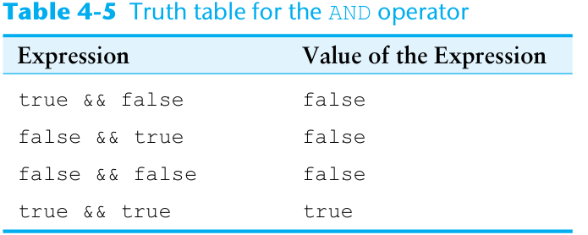
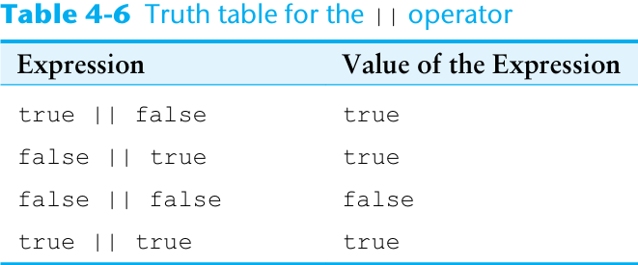
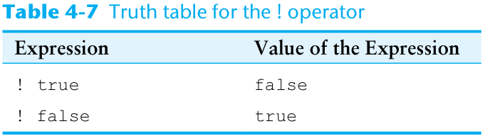

Slide 16
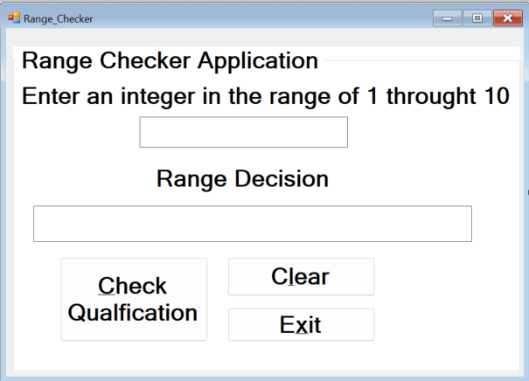
Practice Lap

Slide 17
Sample Decision Structures with Logical Operators
The && operator
if (temperature < 20 && minutes > 12)
{
MessageBox.Show("The temperature is in the danger zone.");
}
The || operator
if (temperature < 20 || temperature > 100)
{
MessageBox.Show("The temperature is in the danger zone.");
}
The ! Operator
if (!(temperature > 100))
{
MessageBox.Show("The temperature is below the maximum.");
}

Slide 18
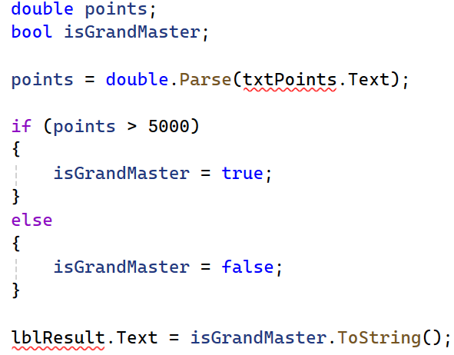
4.5 bool Variables and Flags
You can store the values true or false in bool variables, which are commonly used as flags
A flag is a variable that signals when some condition exists in the program
  false – indicates the condition does not exist
  true – indicates the condition exists

Slide 19
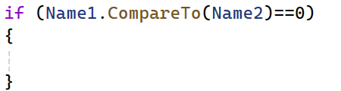
4.6 Comparing Strings
You can use certain relational operators and methods to compare strings. For example,
  The == operator can compare two strings
if (name1 == name2)
{
}
  You can compare string variables with string literals, too
if (name1 != "bob")
{
}
  The String.Compare method can compare two strings
if (String.Compare(name1, name2) == 0)
{
}

Slide 20
4.7 Preventing Data Conversion Exception
Exception should be prevented when possible
The TryParse methods can prevent exceptions caused by users entering invalid data
  int.TryParse
  double.TryParse
  decimal.TryParse
The generic syntax is:
dataType.TryParse(string input, out targetVariable)
The out keyword is required; it specifies that the targetVariable is an output variable

Slide 21
4.8 Input Validation
Input validation is the process of inspecting data that has been entered into a program to make sure it is valid before it is used
TryParse methods check if the user enters the data, but it does not check the integrity of the data. For example,
  In a payroll program we might validate the number of hours worked.
int hours;
if (int.TryParse(textBox1.Text, out hours))
{
// Here TryParse() succeeded — it’s a number!
}
if (hours > 0 && hours <= 168)
  In a program that gets test scores, we can make sure the score is in the range of 0 through 100.
if (testScore >= 0 && testScore <= 100)
Notes:
If the user types 999, TryParse() says ✅ “yes, that’s a valid number.”
But in reality, no one can work 999 hours in a week — so the data is not logical.
This means the data’s integrity (trustworthiness, reasonableness) is not verified.

Slide 22
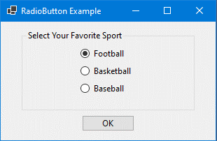
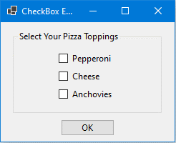
4.9 Radio Buttons and Check Boxes
Radio buttons allow users to select one choice from several possible choices
  Clicking on a radio button, the program automatically deselects any others. This is known as mutually exclusive selection (“you can only pick one at a time.”
Check boxes allows users to select multiple options

Slide 23
RadioButton Control
.NET provides the RadioButton Control for you to create a group of radio buttons
Common properties are:
  Text: holds the text that is displayed next to the radio button
  Checked: a Boolean property that determines whether the control is selected or deselected
In code, use a decision structure to determine whether a RadioButton is selected. For example,
  if (choiceRadioButton.Checked) { } else { }
You do not need to use the == operator, although the following is equivalent to the above
  if (choiceRadioButton.Checked == true) { } else { }

Slide 24
Checkbox Control
The .NET Framework provide the CheckBox Control for you to give the user an option, such as true/false or yes/no
Common properties are:
  Text: holds the text that is displayed next to the radio button
  Checked: a Boolean property that determines whether the control is selected or deselected
In code, use a decision structure to determine whether a CheckBox is selected. For example,
if (option1CheckBox.Checked) { } else { }

Slide 25
The CheckedChanged Event
Anything a radio button or a check box control's Checked property changes, a CheckedChanged event is raised
You can create a CheckedChanged event handler and write code to respond to the event
Double click the control in the Designer to create an empty CheckedChanged event handler similar to:
private void yellowRadioButton_CheckedChanged(object sender, EventArgs e)
{
}

Slide 26
4.10 The switch Statement
The switch statement lets the value of a variable or an expression determine which path of execution the program will take
It is a multiple-alternative decision structure
It can be used as an alternative to an if-else-if statement that tests the same variable or expression for several different values
switch (testExpression)
{
case value_1:
statement;
break;
case value_2:
statement;
break;
default:
statement;
etc.
break;

Slide 27
General Format of the switch Statement
The testExpression is a variable or an expression that given an int, string, or bool value
Each case is an individual subsection containing one or more statements, followed by a break statement
The default section is optional and is designed for a situation when the testExpression will not match with any of the cases

Slide 28

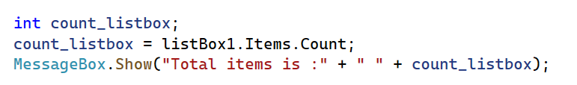
4.11 Introduction to List Boxes
A ListBox controldisplays a list of items and allows the user to select an item from the list
Commonly used properties are:
  Text: Contains the text of the currently selected item in the ListBox
  Items: Contains the items of the ListBox
  Items.Count: Contains the number of items in the ListBox
  SelectedItem: Gets or sets the currently selected item in the ListBox. When the user selects an item, the item is stored in this property. You can use the following to get the selected item from a list box:
selectedFruit = fruitListBox.SelectedItem.ToString();
  SelectedIndex: Gets or sets the zero-based index of the currently selected item in a ListBox
  Gets the text of the currently selected item.
Gets the total number of items in the ListBox.

Slide 29
Adding Items to a ListBox
The Items.Add method allows you to add an item to the ListBox
ListBox.Items.Add(NewItem);
  where ListBox is the name of the ListBox control; NewItem is the value to be added to the ListBox
Example:
daysListBox.Items.Add("Monday");
daysListBox.Items.Add("Tuesday");
daysListBox.Items.Add("Wednesday");

Slide 30
SelectedItem
An exception will occur if you try to get the value of a ListBox’s SelectedItem property when no item is selected
Items in a list box have an index starting with 0
  The first item has index 0, the nth item has index n – 1
  The SelectedIndex property keeps the index. If no item is
  selected the, value of SelectedIndex is – 1
The following is an example using the SelectedIndex property to make sure that an item is selected before the value is gotten from SelectedItem.
if (fruitListBox.SelectedIndex != -1 )

Slide 31
Difference between text , selecteditem
Feature | Text | SelectedItem
Type | string | object
Use case | Quick access to selected text | Full access to the selected item
Flexibility | Less flexible | More flexible (can be cast to object)
Null-safe? | Might return "" if nothing selected | Might be null if nothing selected
Best for | Simple cases with text-only lists | Complex or data-bound lists
Property | Type | Best Use For | Behind the scenes
SelectedItem | object | When working with real data | Can be an object like Student, Book, etc.
Text | string | When you only care about text | Just gives the name shown in the ListBox

Slide 32
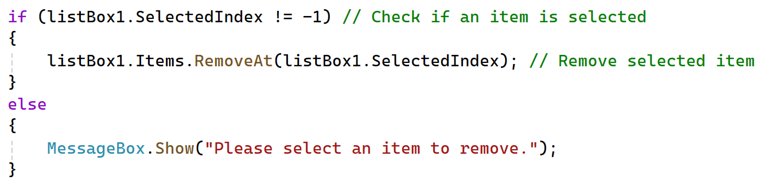
Removing Items From a ListBox (1 of 2)
The Items.Remove method removes a specific item from a ListBox
ListBox.Items.Remove(Item);
  where ListBox is the name of the ListBox control; Item is the item to be removed from the ListBox
Example:
daysListBox.Items.Remove("Tuesday");

Slide 33
Removing Items From a ListBox
The Items.RemoveAt method removes an item at a specific index from a ListBox
ListBox.Items.RemoveAt(Index)
  where ListBox is the name of the ListBox control; Index is the index of the item to be removed from the ListBox
Example:
daysListBox.Items.RemoveAt(2);
Note: the specified index must be a valid index. It cannot be less than 0, or greater than or equal to the number of items in the ListBox. If the index is invalid, the RemoveAt method will throw an exception.
The Items.Clear method erases all the items in the ListBox
Example
daysListBox.Items.Clear();

Slide 34
Copyright
This work is protected by United States copyright laws and is provided solely for the use of instructors in teaching their courses and assessing student learning. Dissemination or sale of any part of this work (including on the World Wide Web) will destroy the integrity of the work and is not permitted. The work and materials from it should never be made available to students except by instructors using the accompanying text in their classes. All recipients of this work are expected to abide by these restrictions and to honor the intended pedagogical purposes and the needs of other instructors who rely on these materials.

